Slide 1


SPAG Spatial agglomeration index - empirical study for business location in NTS2 Polish regions Katarzyna Kopczewska, Paweł Churski, Artur Ochojski, Adam Polko The paper is financed by the Polish National Science Centre www.ncn.gov.pl as the research project in OPUS 6 call, contract No. UMO-2013/11/B/HS4/01098

Slide 2
SPAG – what’s that?
SPAG – Spatial Agglomeration measure
based on geo-located point data for individul firms
to capture with single number the density of locations on the surface
null hypothesis: firms are uniformely distributed over space (spatially uniform distribution) → SPAG measures the degree of divergence from uniform distribution pattern (so agglomeration or border dispersion)
Measure based on geometric concept – using circles representing firms*

Slide 3
Why circles?
When characterizing point location and the magnitude of values in the point, one of the often proposed methods is to represent a point with a shape. This enables analysis on 2D surface. Measures of shape were well described over last sixty years.
Most of them are based on combination of perimeter and area. Shape matters for this combination as the shapes with the same perimeter can have different areas. The closer both these values the lower is the complexity of the shape and the measure is closer to the simple Euclidean geometry (de Smith et al., 2015).
It can be proven that shape which has the biggest area at given perimeter is a circle. Thus circle has the smallest difference between area and perimeter, so is the least complex shape.
Circular shape also gives the border values of many measures of shape (e.g. perimeter^2/area, compactness ratio, fractal dimension index), what guarantees the dimensionless (independence of size of the polygon).
Circle as simple shape is symmetric, can be inscribed in or circumscribed about other figures and solves the isoperimetric problem (de Floriani & Spagnuolo, 2008).
As most of the exercises in geography of shapes and in computational geometry is to simplify the shape, a circle-based measure is in this mainstream.

Slide 4
Why to construct something new?
In last decade in world literature one can find few trials to build new class of specialization/concentration/aglomeration measures, based on geo-points
→ measures were divided into:
- cluster-based (using two-dimensional table)
- distcance-based (using real point locations of firms)
BUT: Those measures are mainly based on Ripley’s K function - Marcon & Puech (2003),
Duranton & Overman (2005), Do & Campante (2009), Duranton & Overman (2008),
Marcon & Puech (2009), Arbia, Espa, Giuliani & Mazzitelli (2010)
→ Only few do not use this concept - global extent (GE) and local density (LD) (Mori & Smith, 2014) and relative density m function (Lang, Macon & Puech, 2014)
BUT: All distance-based measures give as the result the function, which is interpreted „optically” from the plot
BUT: all measures based on Ripley’s K conccept fail to distinguish different spatial patterns

Slide 5
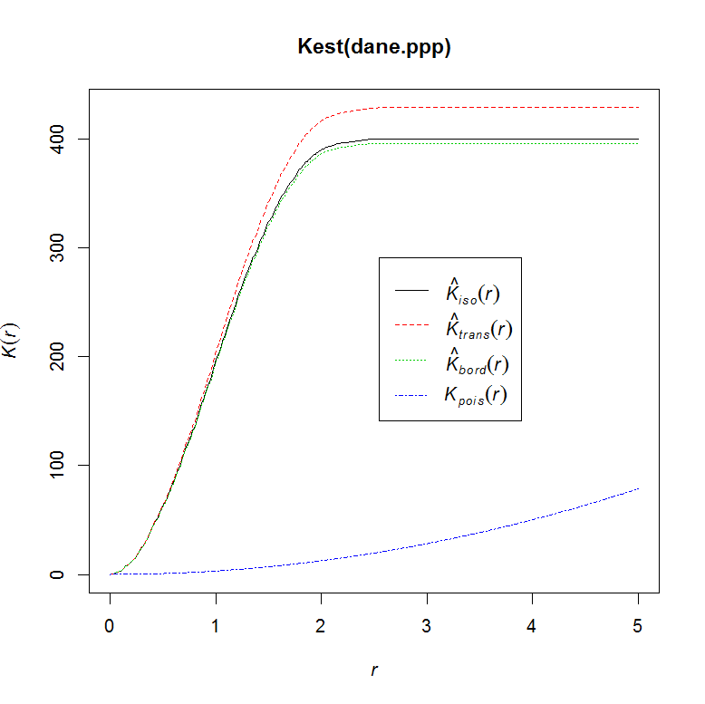
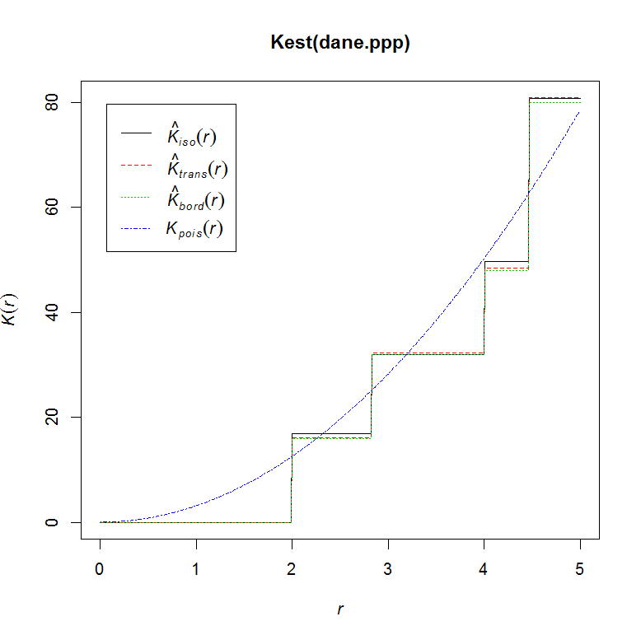
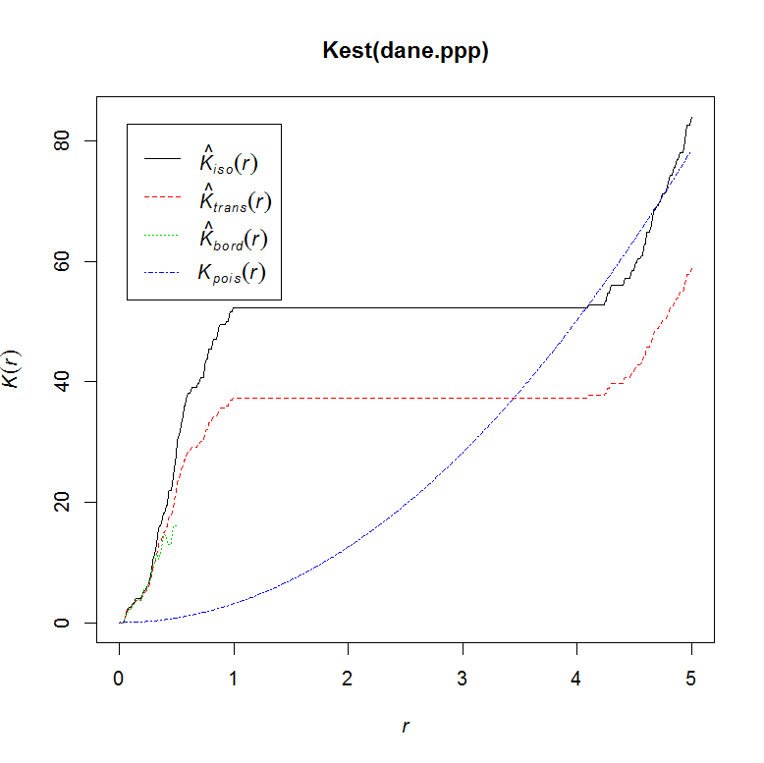
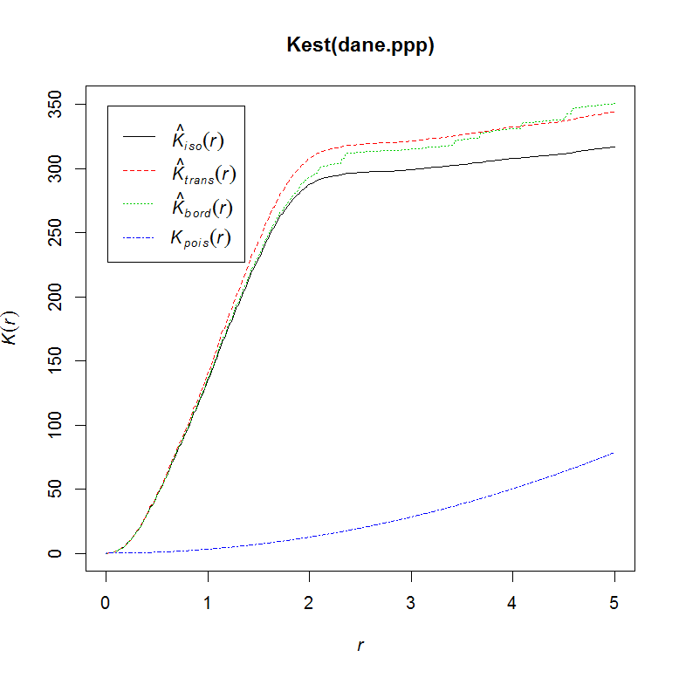

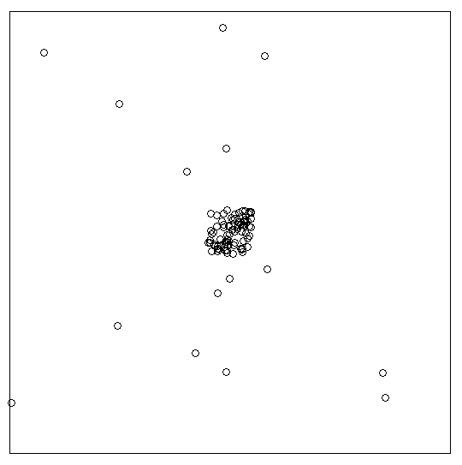
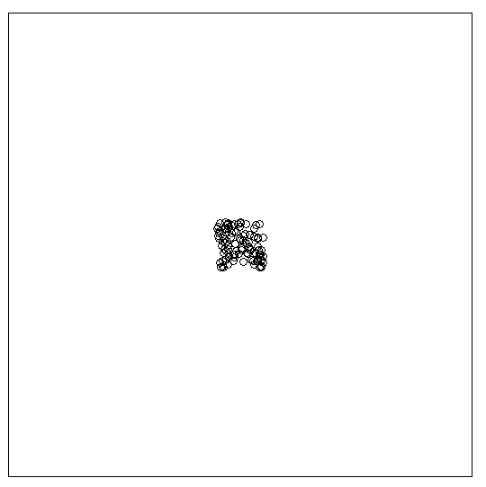
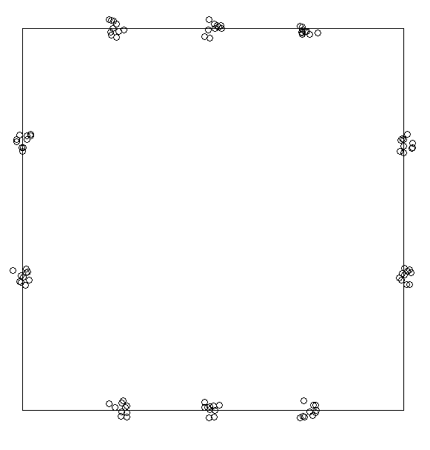
Example: results from Ripley’s K

Slide 6
So…
This class of measures is still poorly popular because :
result are highly unattractive for policy makers and practitioners
results do not reflect spatial point-patterns
measures do not depend on area of studied territory and often size of company does not matter
There is still need to build a new class of measures of agglomeration, based on geo-points which:
do not relies on Ripley’s K
gives „nice” single-value result (as cluster-based measures)
fulfills all condtions of good index by Duranton and Overman and more
SO HERE WE GO !

Slide 7
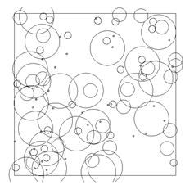
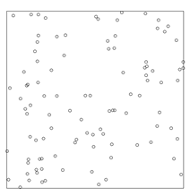
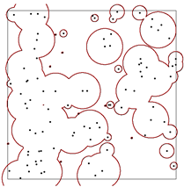
Our proposition SPAG: index of spatial agglomeration
What we mean…
Geo-locations of firms
Circles representing size of firms
Total area of region coverd by impact zones of business
I_{coverage­} = 1
I_{distance} = 1.03
I_{overlap} = 0.69
SPAG = 0.72
SPAG=I_{coverage}*I_{distance}*I_{overlap}

Slide 8

Methodology of constructing our measure (1)
- The starting point is the geo-location of n business units.
By construction, index compares the empirical and theoretical distributions of circles representing firms.
In empirical distribution, each point (x,y) of n firms’ location is appointed by the circle, which area is proportional to employment empl_{i} in the company.
Radii r_{i} of n circles might be continuous variable for precise data on employment or discrete for interval data.
Sum of the a_{i} areas of n circles is equal to the area A of the region.
Radii of the circles create the business impact zones, which are automatically bigger in case of bigger firms.
Setting circles in real business locations is to reflect the phenomena of spatial agglomeration or other spatial patterns.
and
and ( ) ~empirical

Slide 9
Methodology of constructing our measure (2)
To reflect all possible localization scenarios, the construction of SPAG includes three elements:
a) coverage of territory by circles, to enable calculations of relative coverage, with selected sector in relation to all business units
b) average distance between locations, to cover the extreme effects of full concentration and border-dispersed points, as well to distinguish between non overlapping circles strongly dispersed and tightly located
c) the ratio of overlapping circle areas, to measure the degree of departure from spatially uniform (non-overlapping) distribution towards full concentration in single point.

Slide 10



 | Index of coverage | Index of distance | Index of overlap
Index
Measure to be calculated in counter and nominator | Total area of selected k circles | Average distance between k circles | Area covered by selected k circles
Counter Empirical distribution of k circles | Circles of different size Radii of circles from optimization Real location | Circles of different size Radii of circles from optimization Real location | Circles of different size Radii of circles from optimization Real location
Nominator Theoretical distribution under full coverage k=n | Circles of equal size Radii of n circles from optimization Circle packing algorithm to locate circles | Circles of equal size Radii of n circles from optimization Circle packing algorithm to locate circles | Circles of equal size Radii of n circles from optimization Circle packing algorithm to locate circles

Slide 11
Interpretation of SPAG
Reference value SPAG=1 is for the same size companies distributed evenly over the territory.
Values of SPAG<1 reveal patterns of clustering, with extreme value SPAG~0 at one-point cluster.
Values of SPAG>1 prove the existence of border-dispersed pattern and the mechanisms of repulsion.

Slide 12
Simulation results for n=100 firms four classes of companies’ size with equal frequency distribution of size
I_{coverage­} = 1 I_{distance} = 1.03 I_{overlap} = 0.69 SPAG = 0.72 | I_{coverage­} = 1 I_{distance} = 1 I_{overlap} = 0.74 SPAG = 0.74 | I_{coverage­} = 1 I_{distance} = 0.1 I_{overlap} = 0.08 SPAG = 0.008 | I_{coverage­} = 1 I_{distance} = 1.31 I_{overlap} = 0.44 SPAG = 0.57

Slide 13
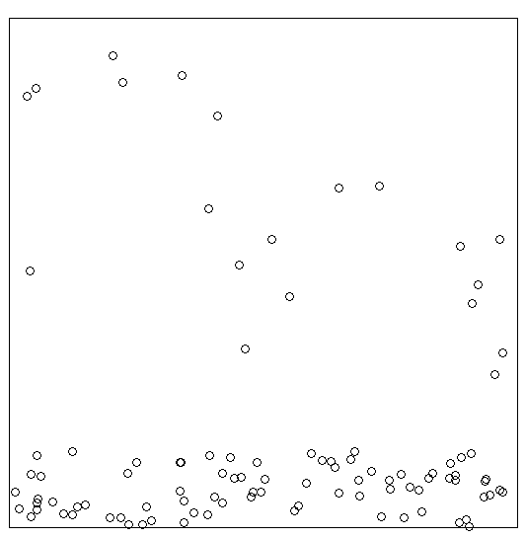
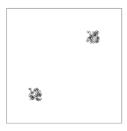
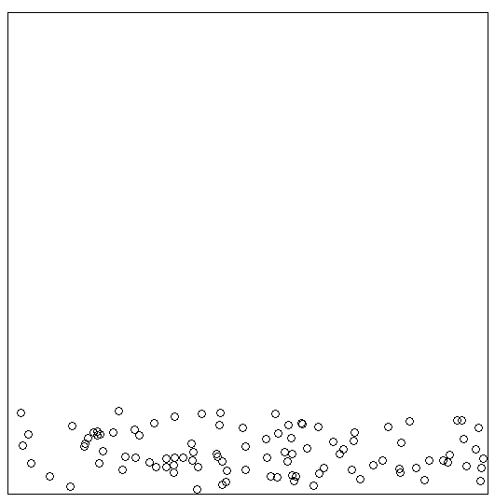
Simulation results for n=100 firms four classes of companies’ size with equal frequency distribution of size
I_{coverage­} = 1 I_{distance} = 0.61 I_{overlap} = 0.28 SPAG = 0.17 | I_{coverage­} = 1 I_{distance} = 0.89 I_{overlap} = 0.46 SPAG = 0.41 | I_{coverage­} = 1 I_{distance} = 0.26 I_{overlap} = 0.23 SPAG = 0.06 | I_{coverage­} = 1 I_{distance} = 0.74 I_{overlap} = 0.13 SPAG = 0.1

Slide 14
Empirical analysis for NTS2 regions in Poland
We used inidividual geo-located data for firms (one NTS2 region is ca.0.5 mln points)
We did many analyses in cross-sections by NTS3, sectors, high-tech industries etc.
Even if for uniform distribution expected value of SPAG is 1, it is unattainable in reality. Empirical analysis of real locations suggests intervals like this:
→ As a relatively uniform distribution of the territory should be treated SPAG = 0.25, and more.
→ SPAG below 0.1 should be treated as spatial agglomeration
→ The main sectors of specialization are the one with the share of employment of approx. 0.5% and more.
→ The share of employment of less than 0.1% should be treated as a marginal

Slide 15
REGON codes for industries
A Agriculture, forestry, hunting and fishing,
B Mining and exploration,
C Industrial processing,
D Producing and supplying in electricity, gas, steam, hot water and air conditioning systems,
E Water supply; wastewater management, waste management and remediation activities,
F Construction,
G Wholesale and retail trade; repair of motor vehicles and motorcycles,
H Transportation and storage,
I Activities related to accommodation and catering services,
J Information and communication,
K Financial and insurance activities,
L Activities related to real estate services,
M Professional, scientific and technical activities,
N Administration and support service activities,
O Public administration and defense; compulsory social security,
P Education,
Q Healthcare and social assistance,
R Activities related to arts, entertainment and recreation,
S Other service activities,

Slide 16
SPAG for NTS2 regions

Slide 17
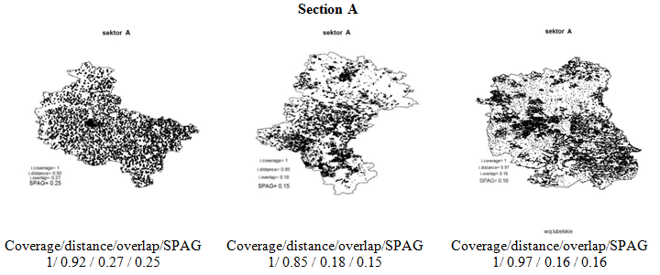
SPAG for NTS2 regions close to uniform distribution Agriculture
Wielkopolskie Śląskie Lubelskie

Slide 18
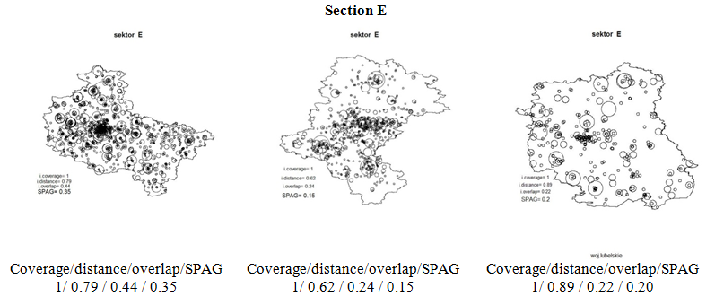
SPAG for NTS2 regions close to uniform distribution Water supply; wastewater management, waste management and remediation activities
Wielkopolskie Śląskie Lubelskie

Slide 19
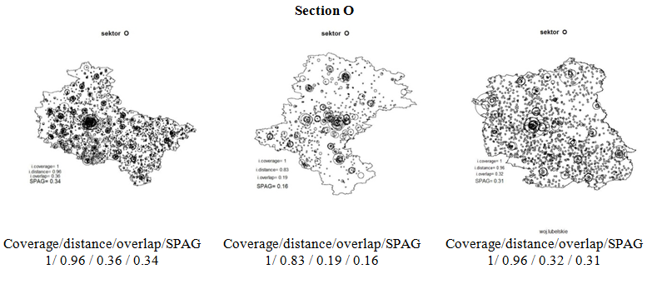
SPAG for NTS2 regions close to uniform distribution Public administration and defense; compulsory social security,
Wielkopolskie Śląskie Lubelskie

Slide 20
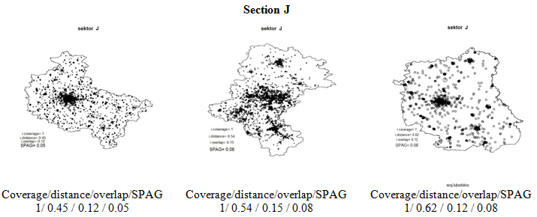
SPAG for NTS2 regions close to agglomeration pattern Information and communication
Wielkopolskie Śląskie Lubelskie

Slide 21
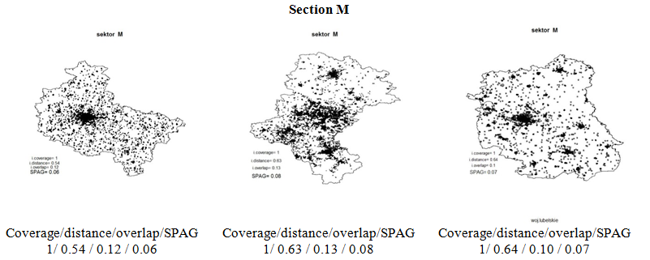
SPAG for NTS2 regions close to agglomeration pattern Professional, scientific and technical activities
Wielkopolskie Śląskie Lubelskie

Slide 22
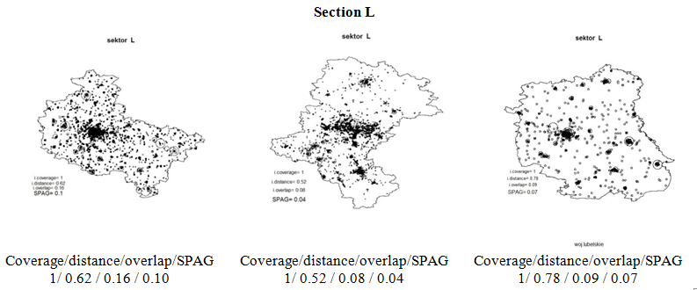
SPAG for NTS2 regions close to agglomeration pattern Activities related to real estate services
Wielkopolskie Śląskie Lubelskie

Slide 23
SPAG for NTS3 regions in Lubelskie NTS2 region

Slide 24
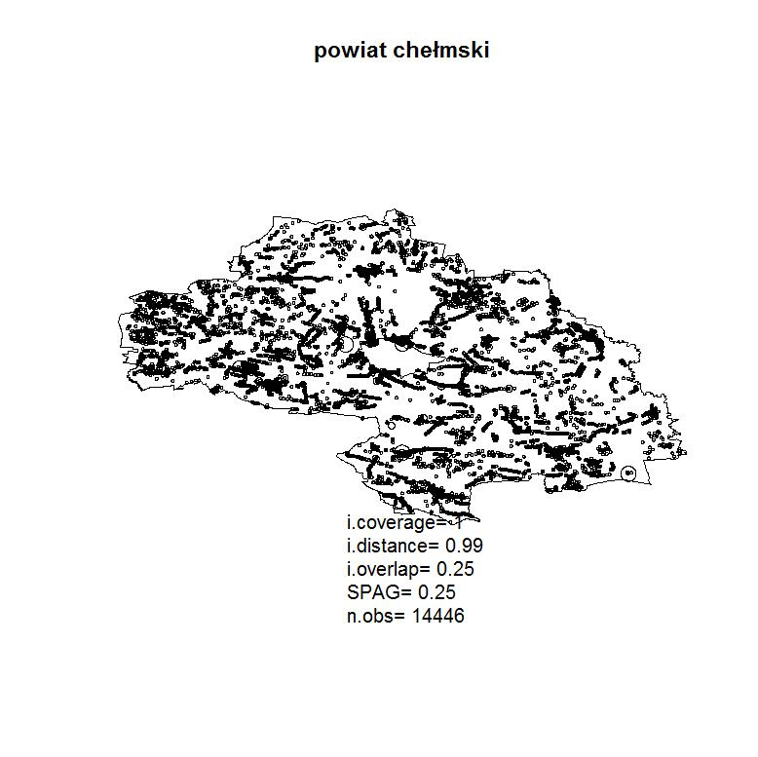
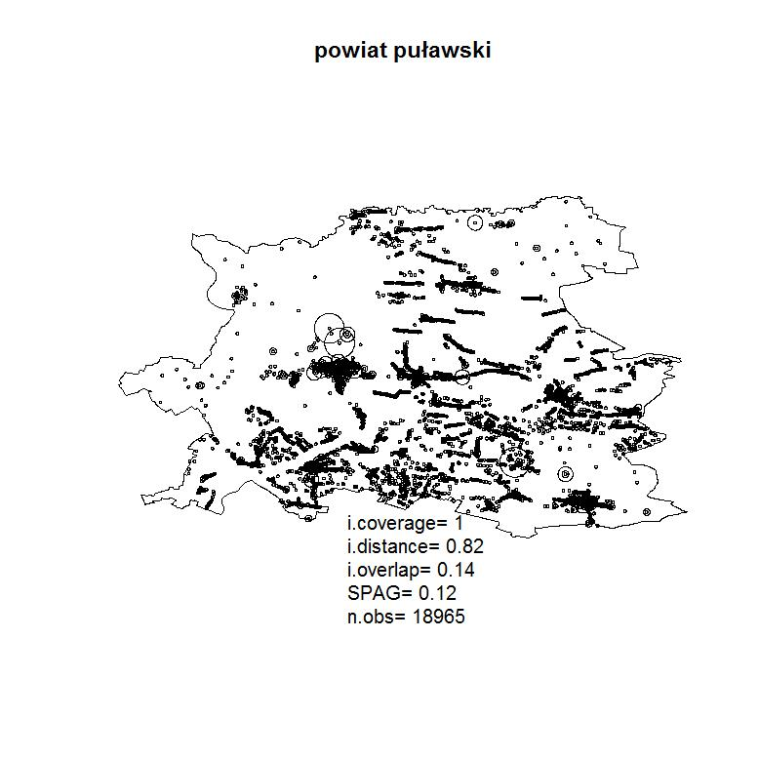
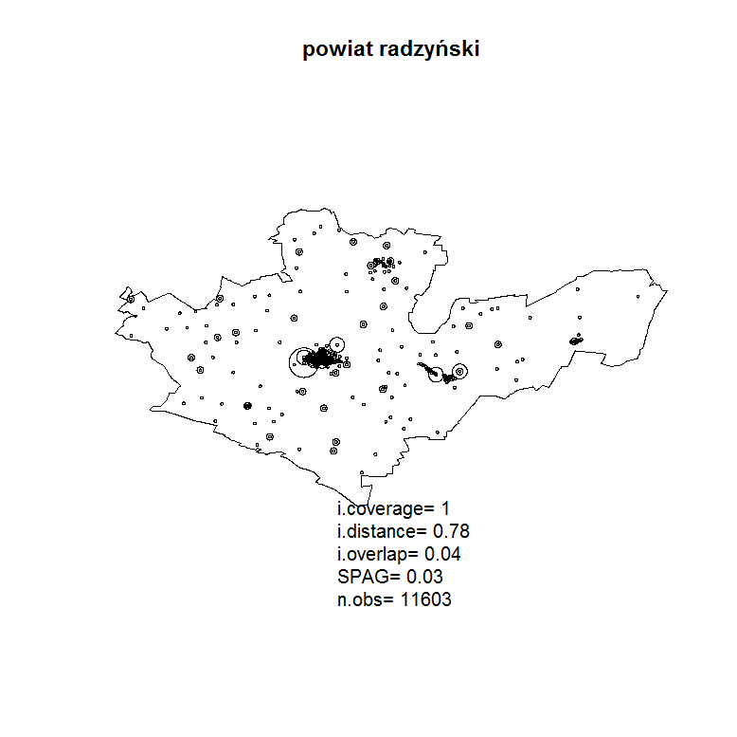
SPAG for NTS3 regions selected NTS 3 regions – all firms on the territory
Coverage/distance/overlap/SPAG Coverage/distance/overlap/SPAG Coverage/distance/overlap/SPAG
1 / 0.99 / 0.25 / 0.25 1 / 0.82 / 0.14 / 0.12 1 / 0.78 / 0.04 / 0.03

Slide 25
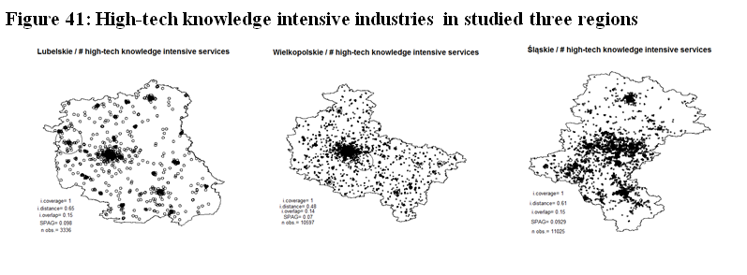
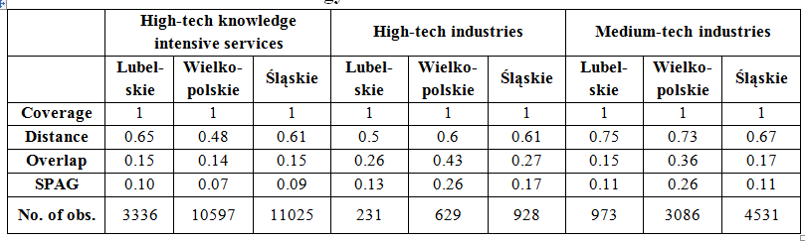
SPAG for NTS2 regions

Slide 26
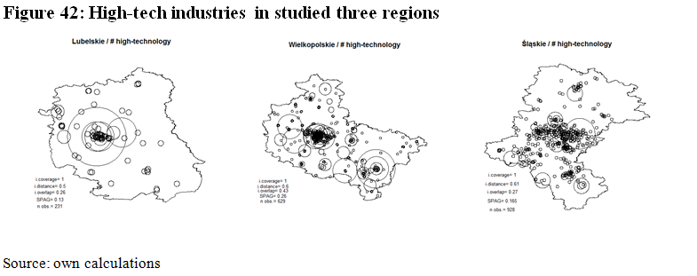
SPAG for NTS2 regions

Slide 27
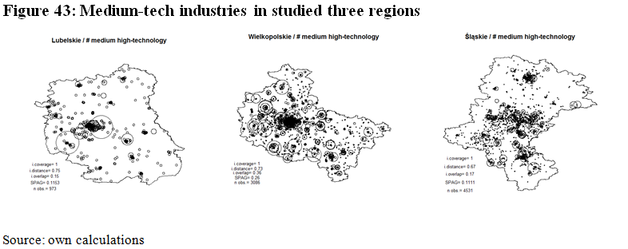
SPAG for NTS2 regions

Slide 28
Testing
SPAG is the function of two variables: spatial distribution of location and distribution of companies’ size.
Empirical SPAG is calculated for empirical locations and empirical size of companies.
In research on spatial location, when number of companies and its size is known, the question under examination is whether spatial distribution of impact of firms is uniform.
Permutation of SPAG can examine the uniformity of spatial location as well as if spatial dispersion of companies’ impact is towards the borders or towards single point (agglomeration).
In permutation test, the companies of size given empirically are permutated over the theoretical space – uniformly distributed points. SPAG_{test} index depending on empirical size of companies in theoretical locations is being calculated.
This allows for (1-α) confidence interval of SPAG_{test}:
SPAG = f(location, size )
SPAG_{empir} = f(location_{empir}, size_{empir} )
SPAG_{test} = f( location_{theor}, size_{empir} )
Pr( SPAG_{test,L} < SPAG_{test} < SPAG_{test,U})=1-α

Slide 29
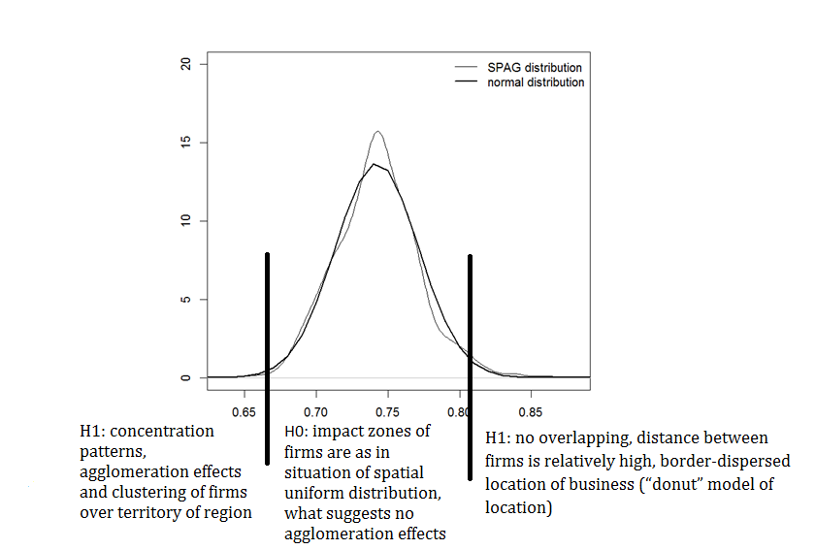
Confidence interval
Distribution of permutated SPAG shows what are the possible results of SPAG if located uniformly.
Different values of SPAG result from overlapping effects which is because of the different size of firms.

Slide 30
Implications
SPAG index is designed to:
measure the degree of spatial agglomeration (concentration, clustering) and distance from uniformity of economic activity.
compare regions, compare the same region over time, compare sectors inside region and between regions and track dynamics of agglomeration or repulsion
- measure the co-location of vertically linked sectors to determine whether they build clusters
- supplement the traditional cluster-based measures by providing the coherent to kxn matrix of economic activity, the kxn matix of SPAG by regions and sectors. These results might be applied to correct for spatial dimension the traditional concentration and specialization measures.

Slide 31
SPAG: Index of spatial agglomeration The paper is financed by the Polish National Science Centre www.ncn.gov.pl as the research project in OPUS 6 call, contract No. UMO-2013/11/B/HS4/01098
Thank you!

